Slide 1
Innovation and Score Reporting
Going Beyond the Passing Status
17 November 2017

Slide 2
Information to be reported
Effective Score Reporting
Why
Focus on score reporting y
What
How
Display and dissemination

Slide 3
Focus on Score Reporting
Test scores are used as evidence to support high stakes decision-making.
Score reports are used for different purposes at different levels of granularity.
Users of score reports have called for more descriptive test information.
Score reports are needed as guide to action.
Score reports should be readily available to the users in a timely manner.
selection, graduation, promotion, admission,
and more
individual, groups,
total
performance, comparison, feedback, remediation
what can I do to improve
timely to decision being made

Slide 4
Focus on Score Reporting
Users need to understand and use the scores and score reports correctly.
Score reports are used by different audiences who may not be as test sophisticated.
Score reports need to be tailored to the user’s need.
Those responsible for testing programs should provide appropriate interpretations.
Validity refers to the degree to which evidence and theory support the interpretations of test scores for the proposed use of tests…. The process of validation involves accumulating relevant evidence to provide a sound scientific basis for the proposed score interpretations.
Those responsible for testing programs should provide appropriate interpretations. The interpretations should describe in simple language what the test covers, what scores mean, the precision of the scores, common misinterpretations of test scores, and how the scores will be used.
The Standards for Educational and Psychological Testing

Slide 5
Problems in Score Reporting
Use mostly aggregated scores with no normative or achievement level connections.
No descriptive information that allows for meaningful interpretations and fair use of test results.

Slide 6
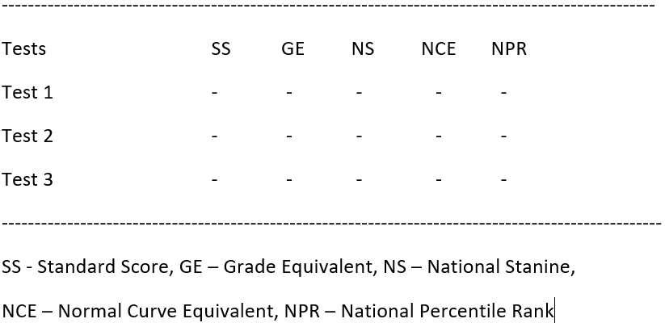
Problems in Score Reporting
Static score reports that include difficult to understand technical terms, symbols and concepts and complex explanation.

Slide 7
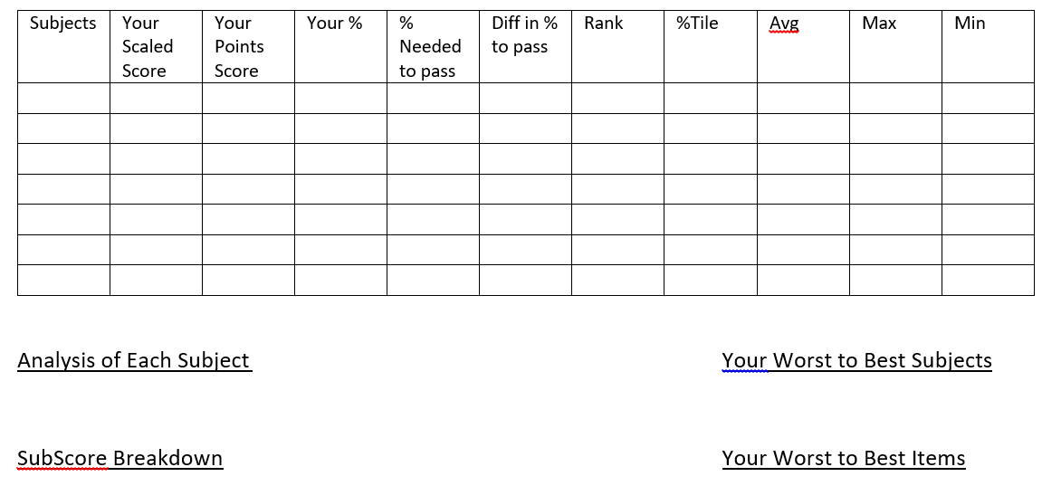
Problems in Score Reporting
Too much information and lack of organization making it difficult for readers to find and extract what they really wanted to know.

Slide 8
Developing Innovative and Effective Score Reports
Significant progress in score reporting in recent time:
Advances in
Number of important work on test score reporting and interpretation
Resources for Reporting Test Scores: A Bibliography for the Assessment Community
Nina Deng and Hanwook Yoo,
Center for Educational Assessment, University of Massachusetts Amherst
assessment design
psychometrics
computer technology

Slide 9
Developing Innovative and Effective Score Reports
Effective diagnostic feedback
Criterion-referenced, norm-referenced, or both
Sub-score reporting
Multi-dimensionality
Reliability
Distinctiveness
Proficiency Levels
Level Descriptors
Performance Comparisons
Growth Information
Score Precision

Slide 10
Developing Innovative and Effective Score Reports
Unambiguous and easily understood feedback
Personalize
Summarize
Familiar
Terms
Group
Various Representation
Minimalism

Slide 11
Developing Innovative and Effective Score Reports
Well-designed interactive web-based score reports
Capability to manage and organize large amounts of information
Choice of generating type of results and analyses
Drill down to provide more details
Flexibility of presentation
Use of multi-media and clickable resources
Easily accessible and timely

Slide 12
Developing Innovative and Effective Score Reports
+ Systemic approach of developing effective score reports
Define reporting purpose
Identify
intended audience(s)
Develop
reports
Evaluate
collect data/field test
Ongoing Maintenance
Revise & Redesign
Review
report examples
Score Report Development Model (Hambleton & Zeinsky)

Slide 13
Score reporting: A work in progress…

